Slide 1
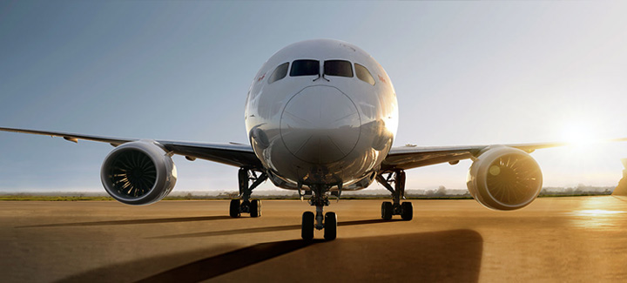
Data Analysis for Customers flying within United States
IST 687 M002 GROUP 3
Yuyu Ko, Shloak Gupta, Satyen Amonkar, Zhenyu Shao, Wenjing Yao

Slide 2
Problem Statement
What are the major attributes affecting the ratings?
What are the reasons for high ratings?
What are the reasons for low ratings?
What can be done to avoid low ratings?
Is gender, type of travel, Airline Status, Flight Distance are affecting Ratings?
Arrival delay, Flight Cancellation, Price Sensitivity are conceived to be important factors. Are they that important?
Do factors like Eating and Shopping which are not directly associated with the flight affect rating?
What are the best models and variables to predict rating of customer?

Slide 3
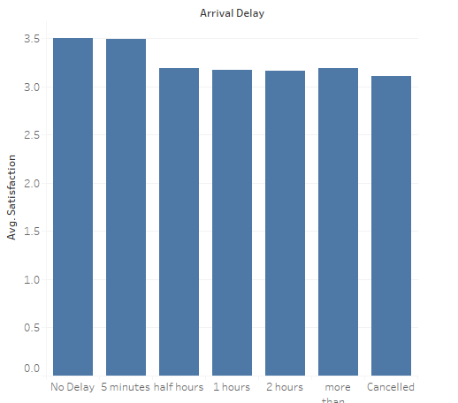
Behavior of factors in particular attributes
Arrival Delay
Average Customers’ Satisfaction group by arrival delay

Slide 4
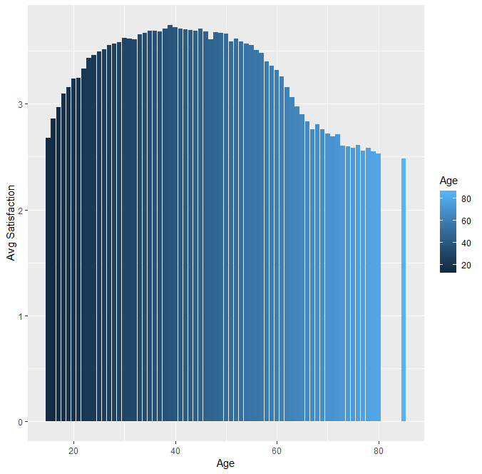
Behavior of factors in particular attributes
Age
Average Customers’ Satisfaction group by age

Slide 5
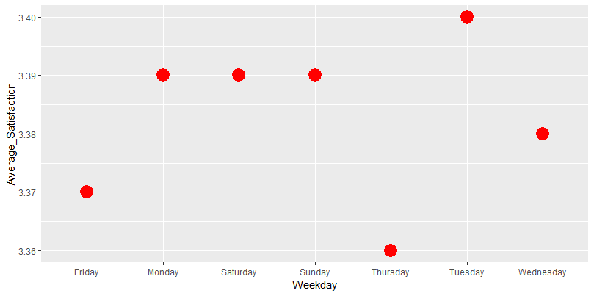
Behavior of factors in particular attributes
Weekdays
Average Customers’ Satisfaction grouped by Weekday

Slide 6
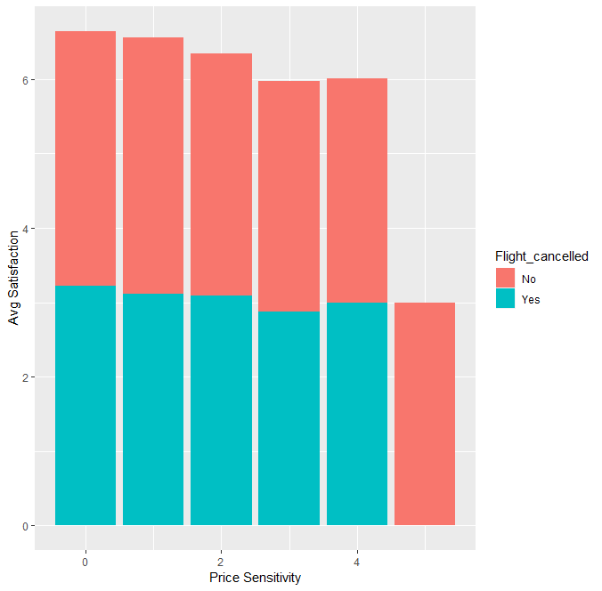
Behavior of factors using multiple attributes together
Average Customers’ Satisfaction grouped by Price Sensitivity and Flight Cancelled

Slide 7
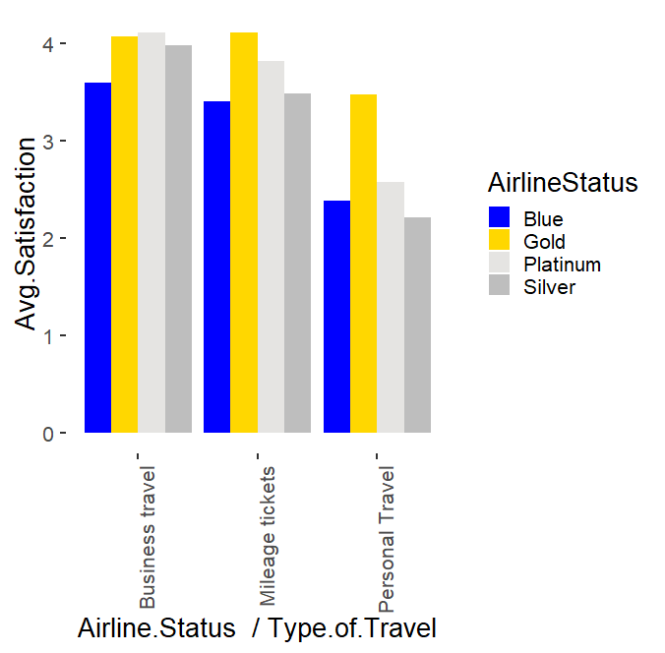
Behavior of factors using multiple attributes together
Average Customers’ Satisfaction group by Airline Status and Type of Travel

Slide 8
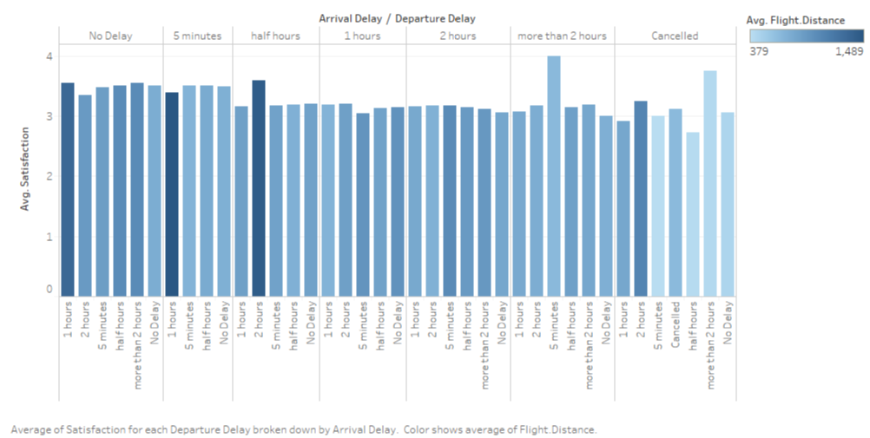
Behavior of factors using multiple attributes together

Slide 9
Models used to predict satisfaction ratings?
Decision tree
Association rule
Linear model
Prediction model from Stepwise regression
KSVM

Slide 10
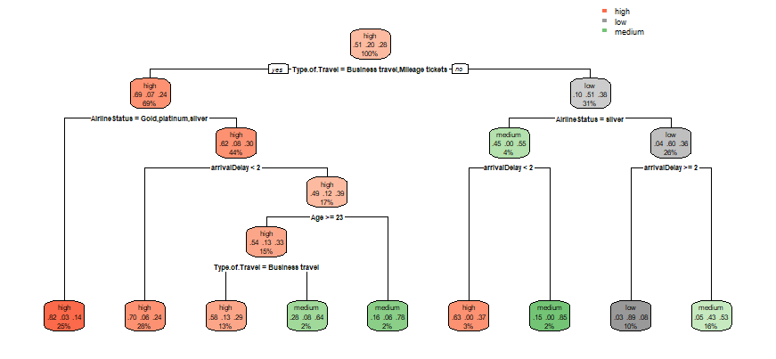
Decision Tree for all data

Slide 11
Finding the significant factors using models
Decision Tree
For the conclusion, we can see that the significant attributes to impact customers’ satisfaction are “Type.of.Travel”, “Airline status”, “arrivalDelay” and “Age”.
If customers’ type of travel = Business Travel or Mileage tickets; Airline status = not Blue; and arrival delay < 2 hours than the customers are highly satisfied. When type of travel is personal; and arrival delay is greater than 2 hours than the customer ratings are low.

Slide 12
Association Rules
[84] {Airline.Status=Blue,
Age=old,
Price.Sensitivity=low,
Type.of.Travel=Personal Travel,
Class=Eco,
Flight.cancelled=No,
arrivalDelay=half hours,
shop_at_airport=No shopping} => {Satisfaction=low} 0.01312659 0.9451220 4.617503 1705
[24] {Airline.Status=Silver,
Gender=Female,
Price.Sensitivity=low,
Type.of.Travel=Mileage tickets,
Flight.cancelled=No} => {Satisfaction=high} 0.006490157 1 1.958608 843
[82] {Airline.Status=Blue,
Age=old,
Gender=Female,
Price.Sensitivity=low,
Years.Old=old,
Type.of.Travel=Personal Travel,
Flight.cancelled=No,
arrivalDelay=half hours} => {Satisfaction=low} 0.01015482 0.9428163 4.606239 1319
[1] {Airline.Status=Silver,
Type.of.Travel=Mileage tickets} => {Satisfaction=high} 0.011871675 1 1.958608 1542
[81] {Airline.Status=Blue,
Age=old,
Gender=Female,
Price.Sensitivity=low,
Type.of.Travel=Personal Travel,
Flight.cancelled=No,
arrivalDelay=half hours,
shop_at_airport=No shopping} => {Satisfaction=low} 0.01069375 0.9474761 4.629005 1389
[14] {Airline.Status=Silver,
Price.Sensitivity=low,
Type.of.Travel=Mileage tickets,
DepartureDelay=No Delay} => {Satisfaction=high} 0.006336179 1 1.958608 823

Slide 13
Association Rules
Most common things that are associated with Higher ratings are
• Type of Travel = Mileage Tickets
• Airline Status = Silver
• Departure Delay = No Delay
• Price Sensitivity = Low
• Flight Cancelled = No
Most common things that are associated with lower ratings are
• Type of travel = Personal
• Price Sensitivity = Low
• Age = Old
• Shop at Airport = No Shopping
• Eating and Drinking = No
• Flight Cancelled = No
• Year Old = Old
• Class = Eco
• Arrival Delays = Half hour or one hour
• Departure Delays = Half hour or one hour
• Airline Status = Blue

Slide 14
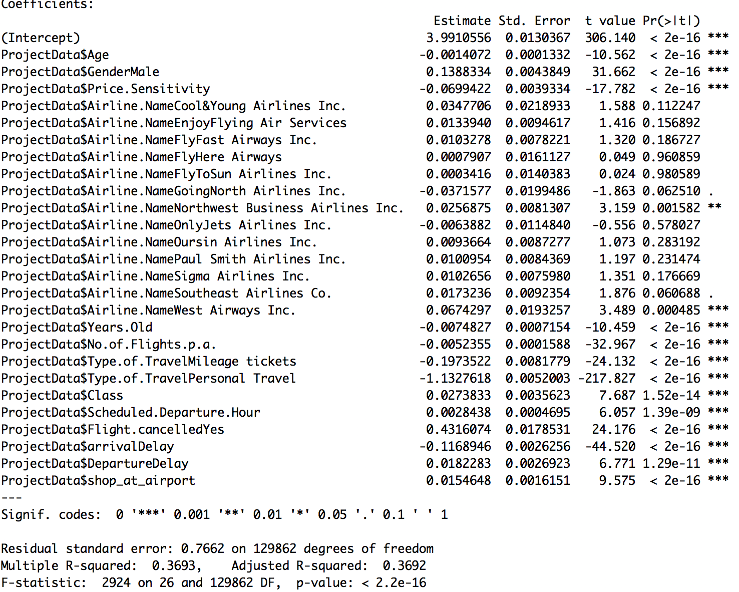
Linear model
Full Model

Slide 15
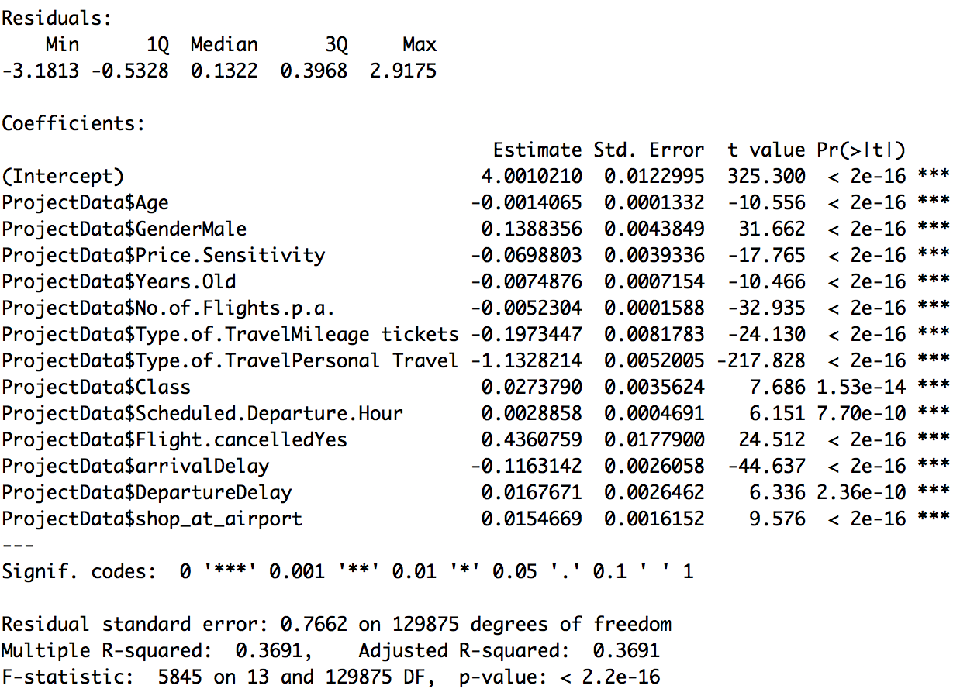
Linear model
Reduced Model

Slide 16
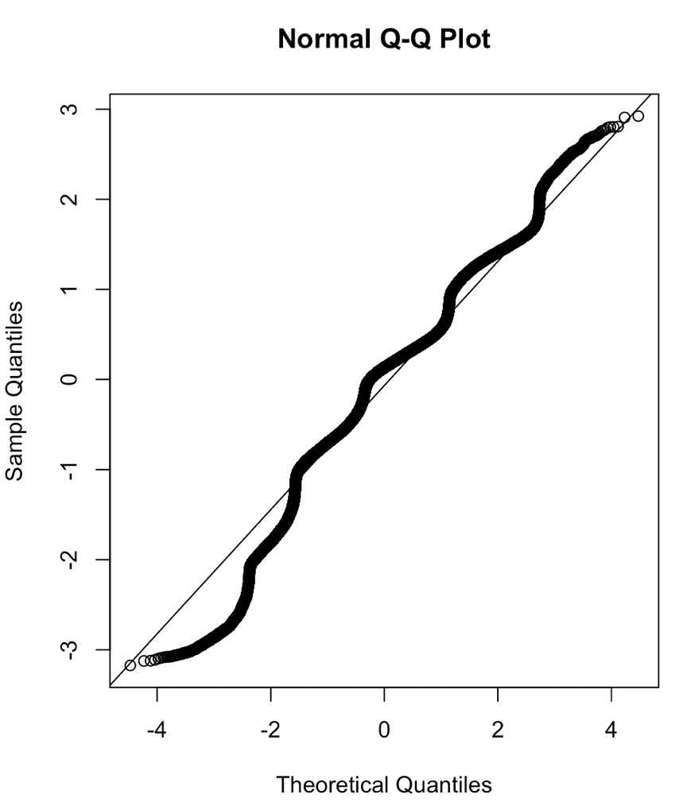

Slide 17
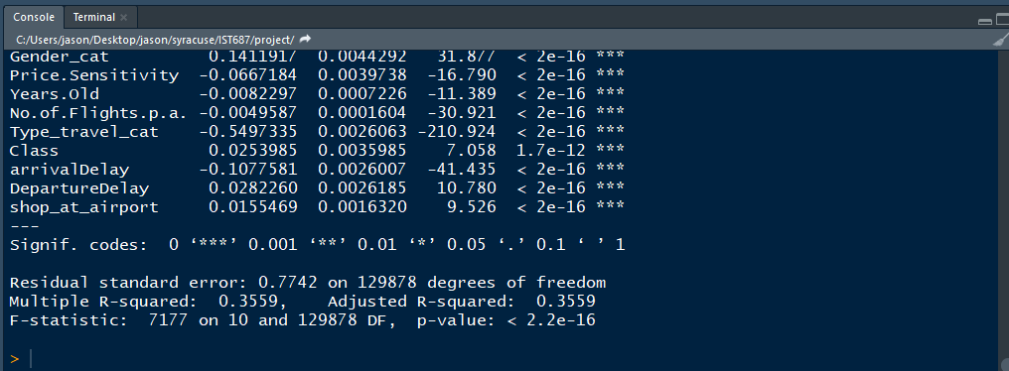
Stepwise Regression

Slide 18
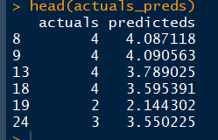
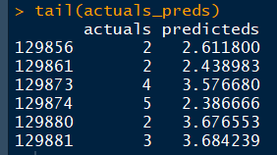

Prediction Model by Stepwise Regression

Slide 19
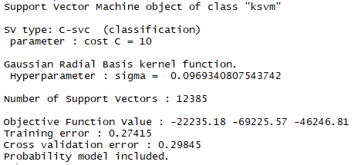
KSVM Modelling
Confusion Matrix
classes | High | Low | Medium
high | 4806 | 54 | 227
low | 397 | 992 | 666
Medium | 1427 | 172 | 1259
Accuracy is 70.57%
This High accuracy in Support Vector Machine shows that the variables we considered were accurate and the Data Preprocessing was appropriate.

Slide 20
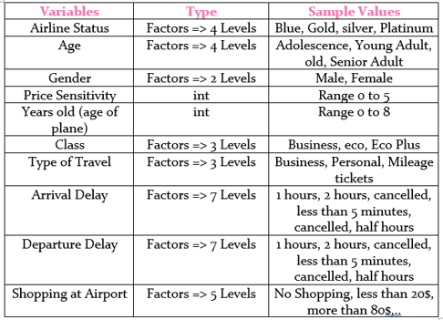
Recommended Significant Variables for Future Models

Slide 21
Insights and Recommendation for Airlines Form these Models and Association Rules
Natural Tendencies that affect Satisfaction Rating but cannot be changed
Natural Tendencies that affect Satisfaction Rating but cannot be changed
Highly satisfied Customers tend to be in
Age: Between 25 to 55
Gender: Male
Years old: Plane not older than 3 years
Airline Status: Silver, Gold, Platinum
Not so satisfied Customers tend to have
Age: Young Or older than 55
Gender: Female
Years old: Travelling in Older planes
Airline Status: Blue
Number of Flights per annum less than 5

Slide 22
Insights and Recommendation for Airlines Form these Models and Association Rules
Things that can be worked on to improve Satisfaction Rating
People with High Satisfaction
Arrival delay: No Delay
Departure Delay: No Delay
Price Sensitivity: 0 to 3
Shopping at Airport: They do Shop at Airport
Type of Travel: Mileage Tickets
Things to work on as these cause Lower Ratings
Arrival Delay: More than two Hours
Departure Delay: More than two Hours
Flight Cancelled: Yes
Type of Travel: Personal
Price Sensitivity: 3 to 5
Shopping and Eating: No Shopping & No Eating

